Slide 1
Routine Dry Eye Screening for New Medication
Aman Mittal, MD
Cornea and Refractive Surgery Fellow
Gavin Herbert Eye Institute
University of California, Irvine

Slide 2
Disclosures
I have no relevant financial disclosures

Slide 3
CC: “Dry Eye Evaluation”
58 yo M presents for baseline screening exam before starting a new medication that he was told can make his dry eye worse
Denies any dry eye symptoms including blurry vision, burning, pain, FBS, redness, tearing OU
Vision stable, last eye exam 8 years ago

Slide 4
PMH: Multiple myeloma, anemia, AF
PSHx: Portacath placement, strabismus surgery
POHx: Strabismus
SHx: +Smoking
FHx: No significant history
Allergies: NKDA

Slide 5
Exam
 | Right eye | Left eye
External | Normal | Normal
VA | sc 20/30 +2 | sc 20/40 -2
Pupil | briskly reactive, no RAPD | briskly reactive, no RAPD
Motility | Full | Full
IOP | 16 mmHg | 14 mmHg
CVF | Full | Full

Slide 6
Manifest Refraction
OD | -1.25 +0.25 @ 170 | 20/20
OS | -2.00 +0.25 @ 095 | 20/20

Slide 7
Slit Lamp Exam
 | Right eye | Left eye
Lids/Lashes | 1+ MGD, mild blepharitis | 1+ MGD, mild blepharitis
Conjunctiva/Sclera | White and quiet | White and quiet
Cornea | Clear, no SPK | Clear, no SPK
Anterior Chamber | Deep and quiet | Deep and quiet
Iris | Round, flat | Round, flat
Lens | Tr NS, mild cortical changes | Tr NS
Anterior vitreous | Normal | Normal
Optic Nerve | Healthy contour, 0.35 C/D | Healthy contour, 0.35 C/D
Fundus | Normal | Normal

Slide 8
Diagnosis/Treatment
MGD and blepharitis OU – start warm compresses and lid scrubs
NS OU – observe
RTC a few weeks after starting new medication

Slide 9
6 weeks later…
Started new medication 2 weeks ago
Vision slightly blurry for last couple of days
Using PFATs TID-QID OU

Slide 10
Exam
 | Right eye | Left eye
VA | sc 20/40 | sc 20/40
Cornea | Tr SPK, low tear meniscus | Tr SPK, low tear meniscus

Slide 11
Diagnosis/Treatment
MGD and blepharitis OU – start warm compresses and lid scrubs
Dry Eye OU – increase PFATs to 6x/day
RTC 3 weeks per protocol prior to next dose

Slide 12
1 week later…
Unscheduled visit
Reading vision very blurry for 2-3 days
Distance vision stable
Was to have next infusion yesterday, but held due to vision changes

Slide 13
Exam
 | Right eye | Left eye
VA | sc 20/30, J3 | sc 20/25, J10
Manifest Refraction
OD | -0.25 +1.00 @ 040 | 20/20
OS | +0.25 +0.75 @ 015 | 20/20
Prior
OD | -1.25 +0.25 @ 170 | 20/20
OS | -2.00 +0.25 @ 095 | 20/20

Slide 14
Exam
 | Right eye | Left eye
Cornea | 1+ SPK inferiorly, low tear meniscus, numerous small epithelial opacities in circular pattern mid-peripherally with overlying fluorescein staining | 1+ SPK inferiorly, low tear meniscus, numerous small epithelial opacities in circular pattern mid-peripherally with overlying fluorescein staining

Slide 15
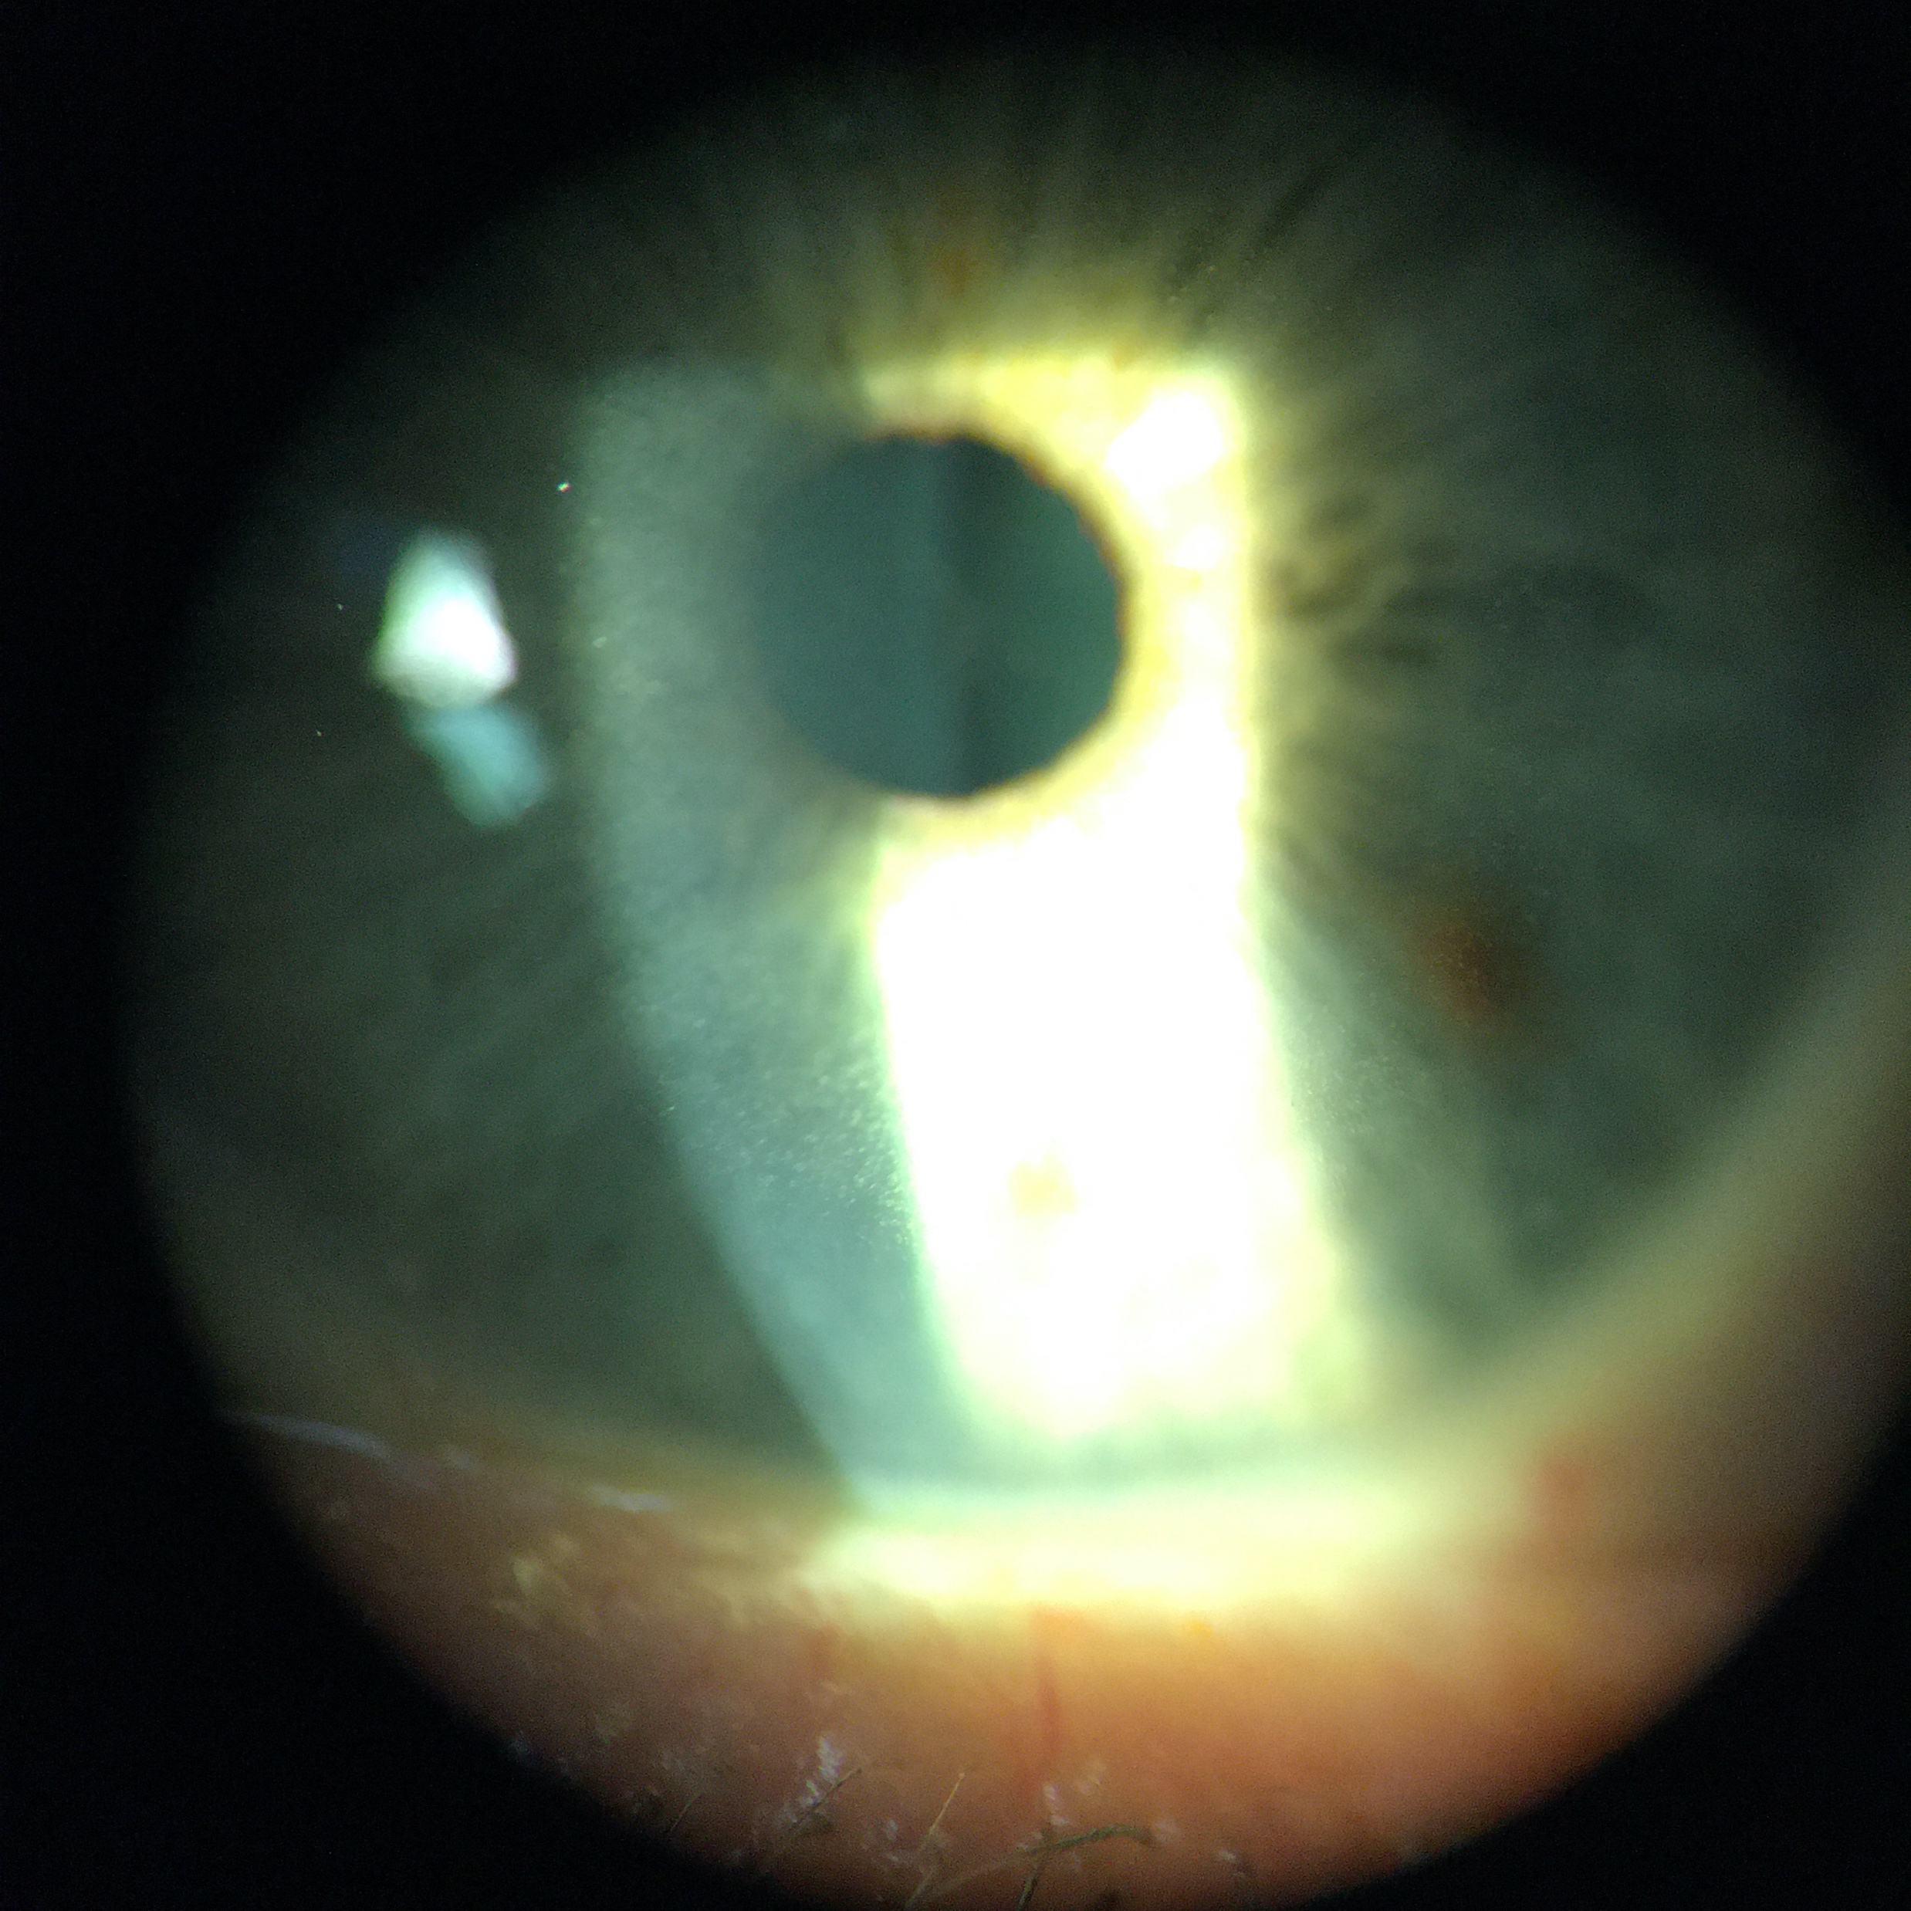

Slide 16
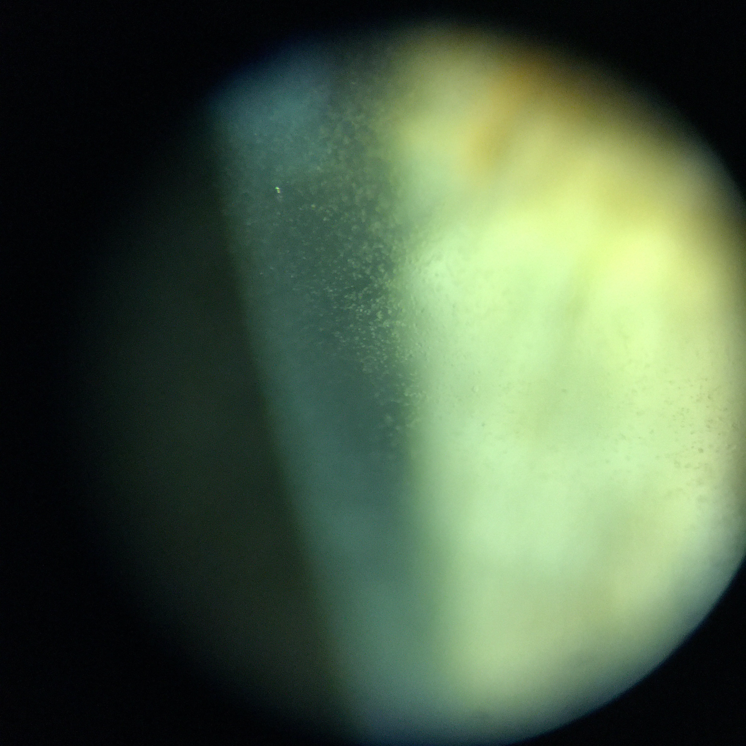

Slide 17
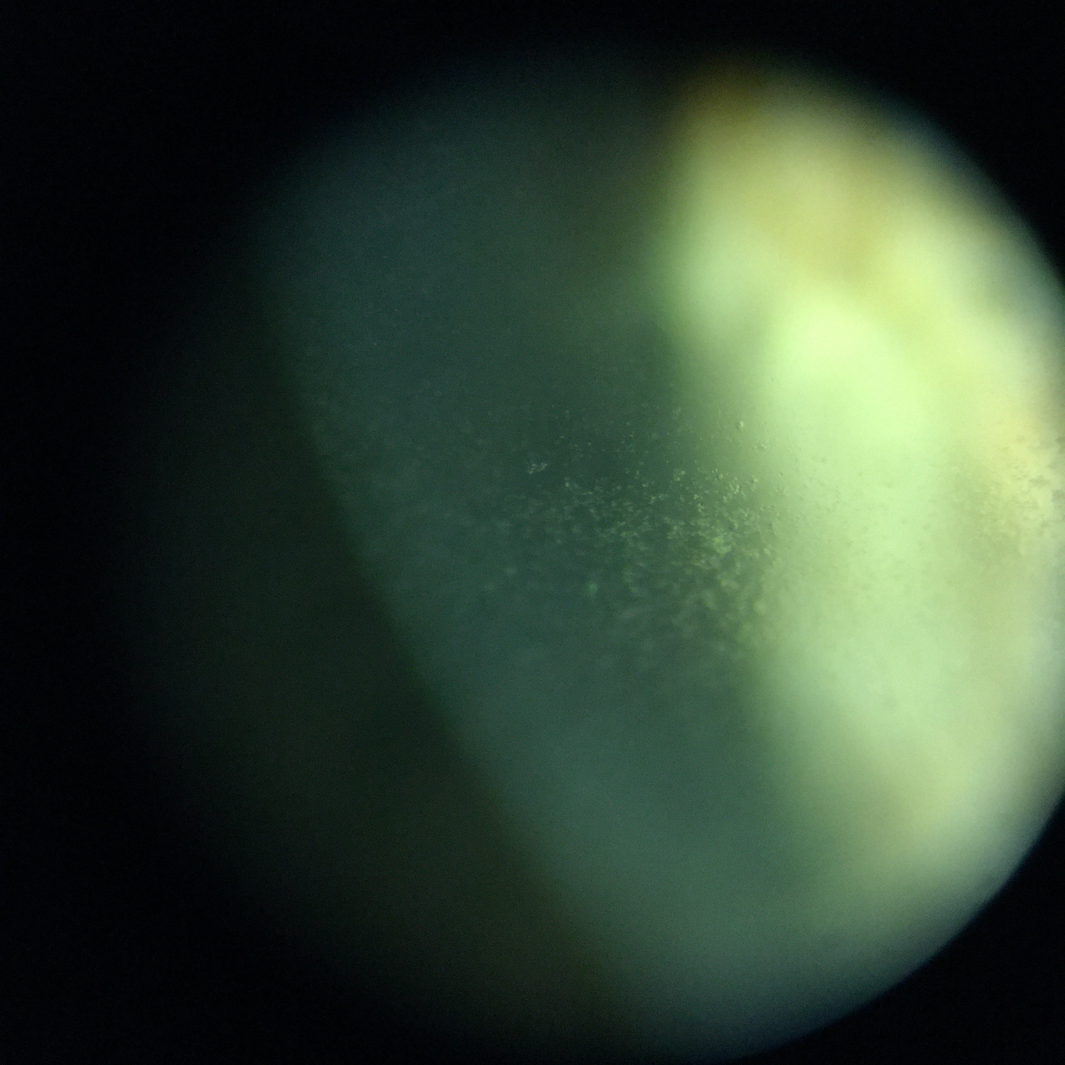

Slide 18
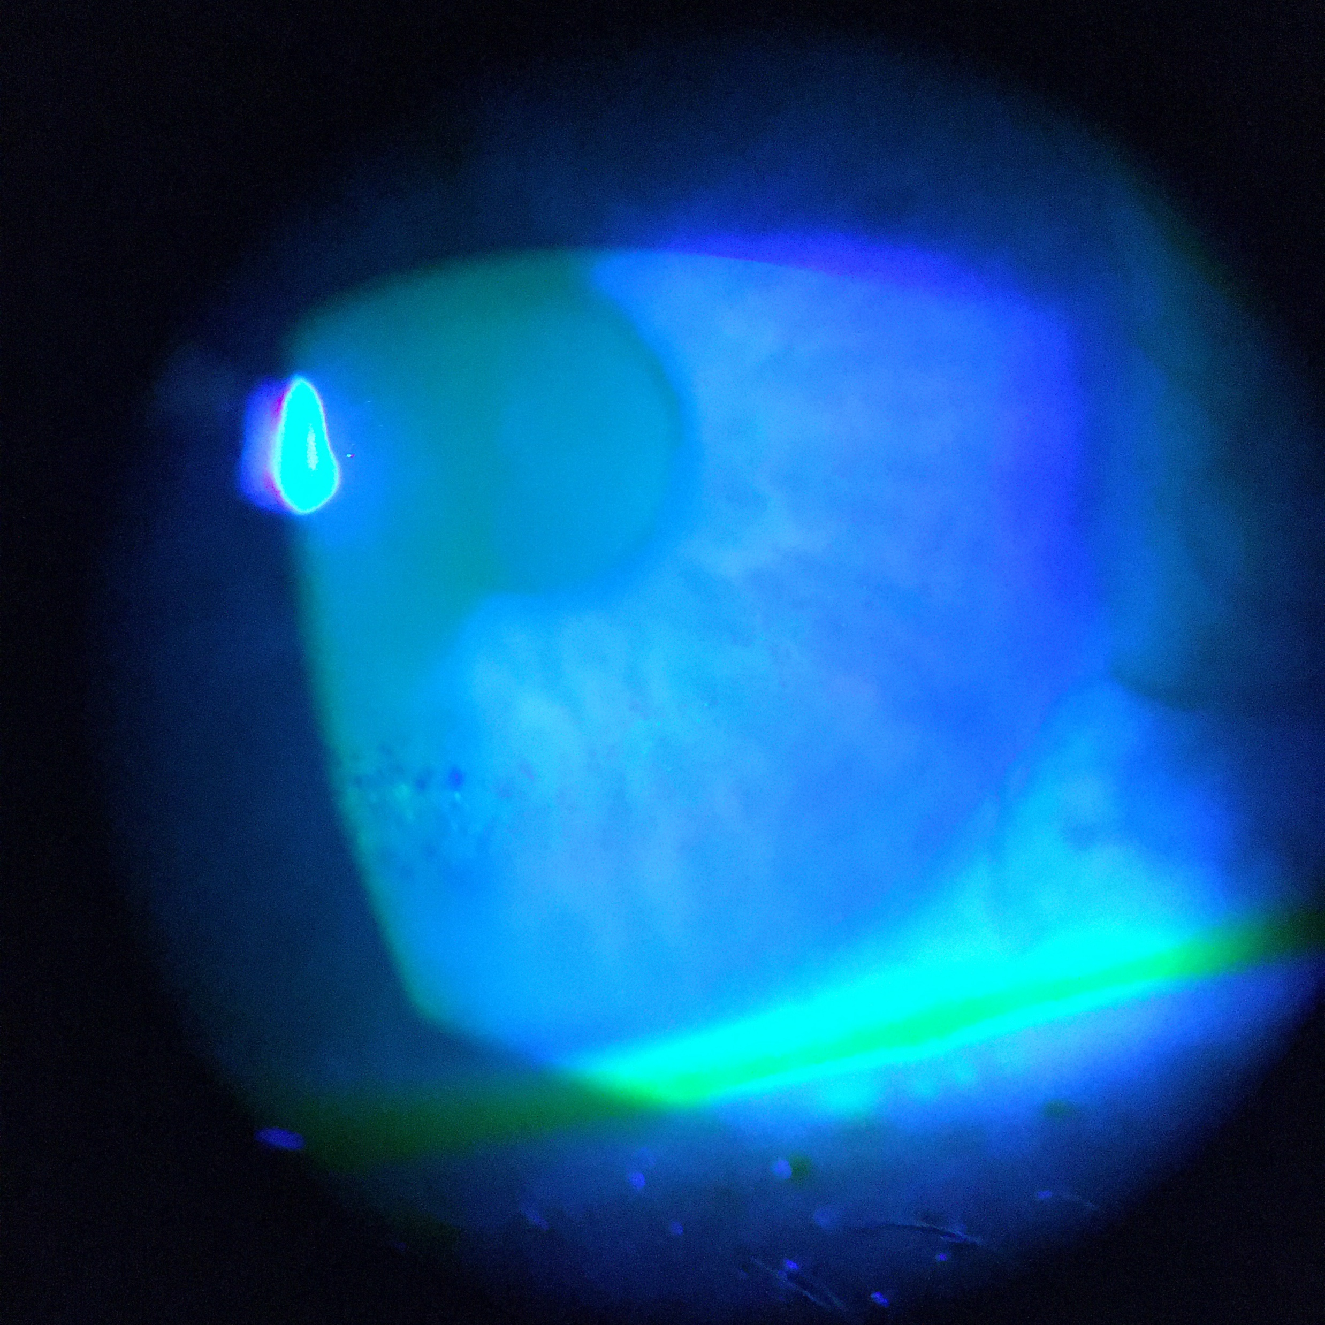

Slide 19
AS-OCT
OD
OS

Slide 20
AS-OCT
OD
OS

Slide 21
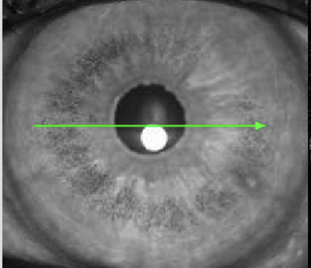

Slide 22
Tomography

Slide 23
Discussion

Slide 24
Diagnosis/Treatment
MGD and blepharitis OU – start warm compresses and lid scrubs
Dry Eye OU – increase PFATs to 6x/day
Refractive error – hyperopic shift secondary to crystalline/cystic epithelial opacities

Slide 25
Diagnosis/Treatment
Recommend adding lifitegrast BID OU and continuing chemotherapy
Patient would like to discontinue chemo due to vision changes
To discuss with oncologist
RTC 3 weeks

Slide 26
3 weeks later…
Stopped medication after consultation with oncologist
Vision fluctuating, but reading vision improving

Slide 27
Exam
 | Right eye | Left eye
VA | sc 20/40 | sc 20/70
Manifest Refraction
OD | -4.25 +1.25 @ 120 | 20/40
OS | -4.00 +1.25 @ 015 | 20/20
Prior
OD | -0.25 +1.00 @ 040 | 20/20
OS | +0.25 +0.75 @ 015 | 20/20

Slide 28
Exam
 | Right eye | Left eye
Cornea | 1+ SPK inferiorly, low tear meniscus, numerous small epithelial opacities in circular pattern more centrally with overlying fluorescein staining | 1+ SPK inferiorly, low tear meniscus, numerous small epithelial opacities in circular pattern more centrally with overlying fluorescein staining

Slide 29
AS-OCT
OS

Slide 30
AS-OCT
OS

Slide 31
Tomography

Slide 32
Diagnosis/Treatment
MGD and blepharitis OU – continue warm compresses and lid scrubs
Dry Eye OU – continue PFATs 6x/day
Refractive Error – epithelial opacities moving centrally with turnover, now causing myopic shift
RTC 3 weeks

Slide 33
3 weeks later…
Vision continues to fluctuate, but overall reading vision improving
Now on dexamethasone

Slide 34
Exam
 | Right eye | Left eye
VA | sc 20/70 | sc 20/70
Manifest Refraction
OD | -2.25 +1.00 @ 145 | 20/20
OS | +0.25 +0.75 @ 015 | 20/25
Prior
OD | -4.25 +1.25 @ 120 | 20/40
OS | -4.00 +1.25 @ 015 | 20/20

Slide 35
Exam
 | Right eye | Left eye
Cornea | 1+ SPK inferiorly, low tear meniscus, numerous small epithelial opacities in circular pattern more centrally with overlying fluorescein staining | 1+ SPK inferiorly, low tear meniscus, numerous small epithelial opacities in circular pattern more centrally with overlying fluorescein staining

Slide 36
Tomography

Slide 37
Diagnosis/Treatment
MGD and blepharitis OU – continue warm compresses and lid scrubs
Dry Eye OU – continue PFATs 6x/day
Refractive Error – vision improving, MRSE closer to baseline, CPM
RTC 1 month

Slide 38
Discussion

Slide 39
Belantamab mafotidin – blmf
Antibody-drug conjugate – IgG1 directed against B-cell maturation antigen (BCMA), expressed on normal B-cells and multiple myeloma cells
Small molecule is MMAF, a microtubule inhibitor – when antibody is bound to BCMA, MMAF is released and induces apoptosis
Approved via orphan drug designation

Slide 40
BLACK BOX WARNING
Belantamab caused changes in the corneal epithelium resulting in changes in vision, including severe vision loss and corneal ulcer, and symptoms, such as blurred vision and dry eyes. Conduct ophthalmic exams at baseline, prior to each dose, and promptly for worsening symptoms. Withhold Belantamab until improvement and resume, or permanently discontinue, based on severity. Belantamab is available only through a restricted program, called the Belantamab REMS.

Slide 41
In clinical trials, dose was reduced in effort to reduce toxicity, but was still significant (27% of patients, 1% discontinued medication)
Lyophilized subgroup (easier to transport, administer) had increased incidence of microcyst-like epithelial changes (MECs), reaching 96% after cycle 10
MECs and BCVA improved after dose delays/cessation of drug – onset of blurred vision after median 26 days, duration of median 43 days
Recommendation is to hold dose for grade 2 events, hold and then reduce dose for grade 3 events, and stop for grade 4 events

Slide 42
Antibody-drug conjugates (SGN-CD19A, AGS-16M8F) including MMAF associated with epithelial keratopathy, treated with PFATs ± topical steroids with improvement
On-target – antibody-mediated delivery
Off-target – delivery of unconjugated cytotoxin
Focal separation between epithelium and basement membrane or direct toxicity to limbal stem cells could result in cystic pattern observed

Slide 43
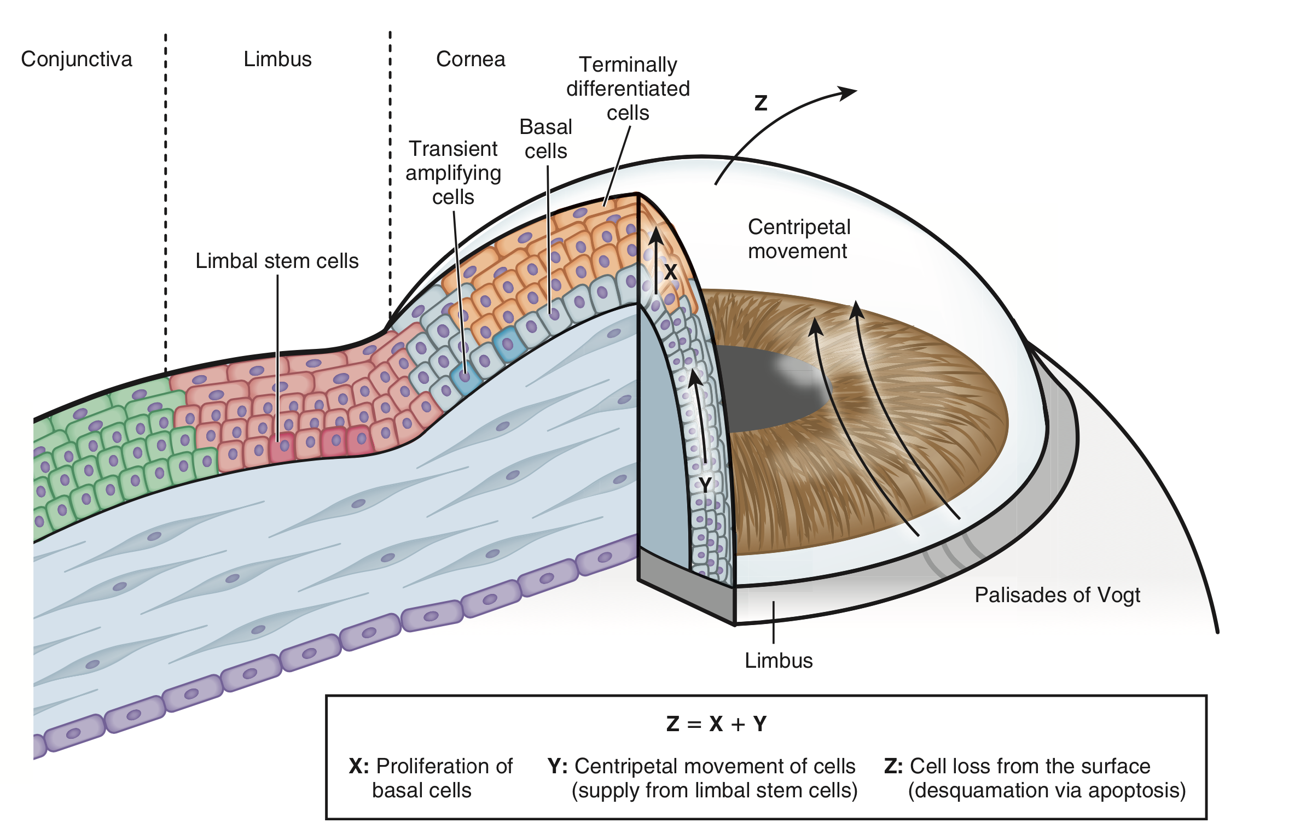
Basal cells generated from limbal stem cells proliferate, differentiating into superficial layers in 7 days
Centripetal movement of epithelial cells in mouse models
17 μm/day for superficial and wing cells
26 μm/day for basal cells
Epithelial remodeling s/p PRK about 1-3 months
Median time to resolution of blurry vision in trial 43 days

Slide 44
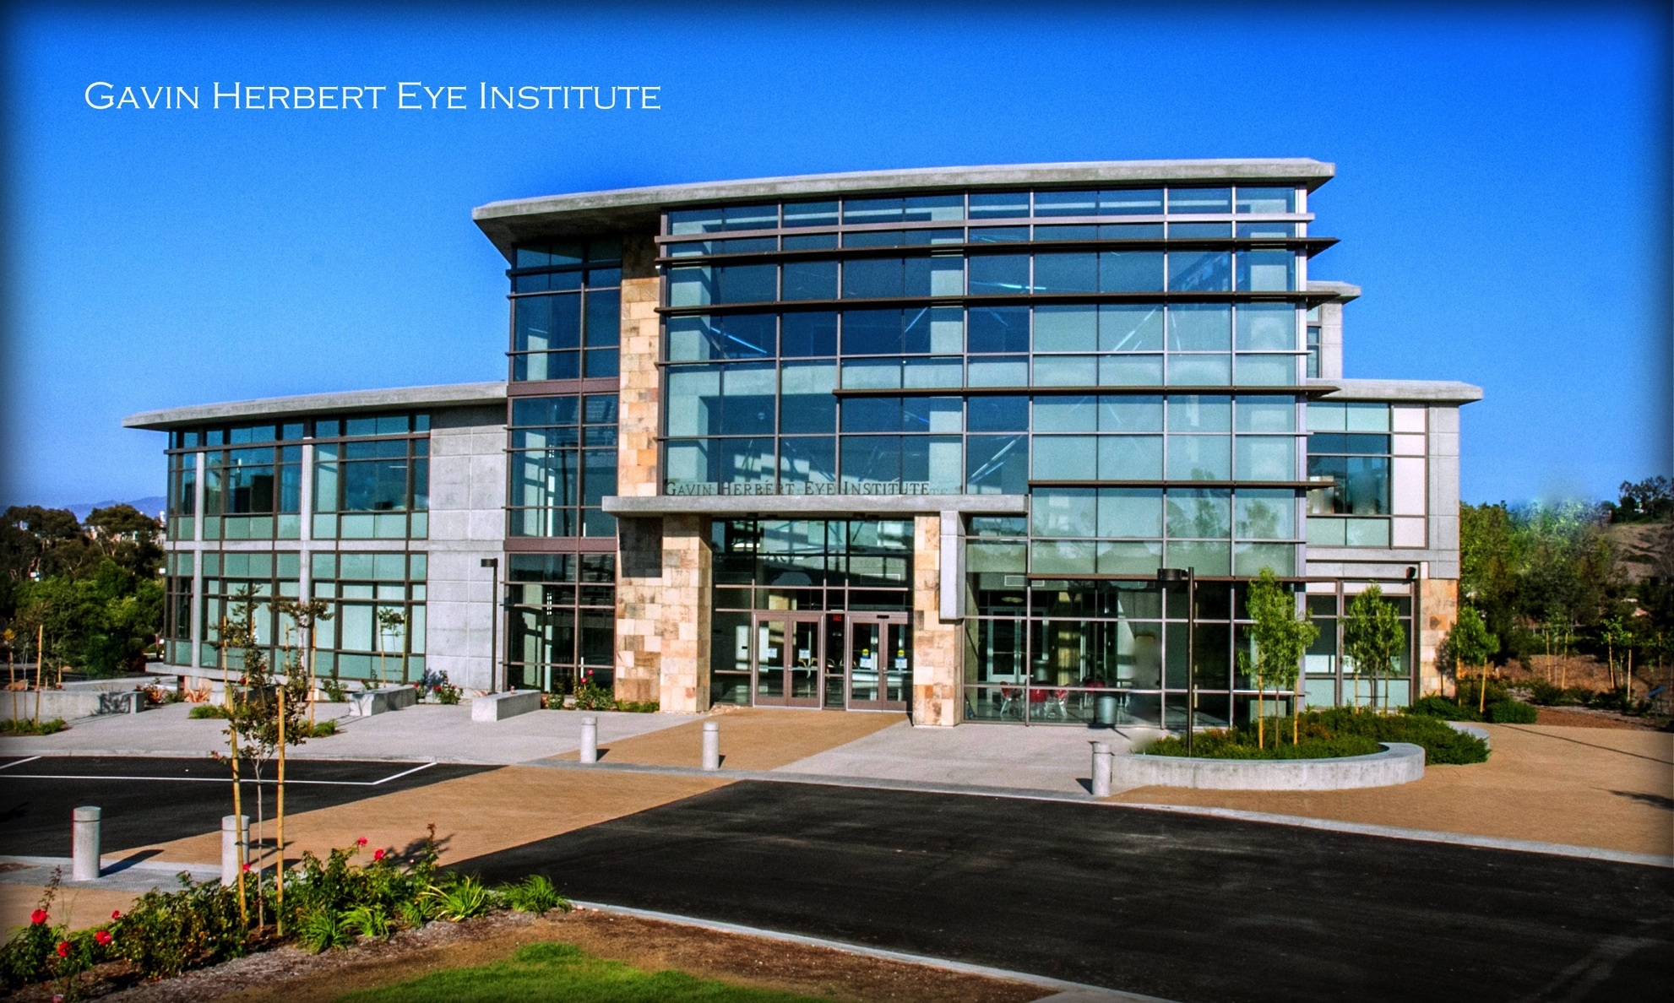
Thank you!

