Slide 1
Will that Really Come Together?
Austin S. Nakatsuka, MD
Clinical Fellow, Glaucoma and Anterior Segment
Craig J. Chaya, MD
Associate Clinical Professor, Glaucoma and Anterior Segment
University of Utah Moran Eye Center

Slide 2
Conflicts of Interest and Disclosures
None

Slide 3
CASE PRESENTATION
A 66 year old woman presented with a large iris defect 1 year following iris melanoma resection

Slide 4
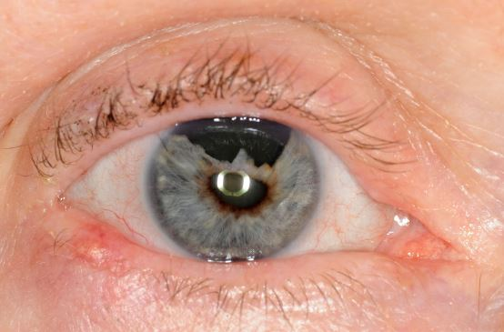

Slide 5
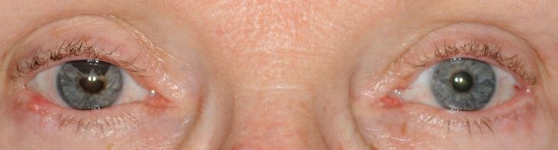

Slide 6
CASE PRESENTATION
Visual Acuity OD: 20/40
Nuclear/Posterior Subcapsular Cataract OD
Rapid visual decline but no dysphotopsias
Otherwise normal exam, no recurrence of melanoma

Slide 7
CASE PRESENTATION
An iris prosthesis was suggested, however, due to insurance issues, she was not able to wait for the prosthesis to be made and requested an intervention as soon as possible
What are her available options?

Slide 8
CASE PRESENTATION
The patient requested cataract surgery with iris repair at the time of surgery if possible

Slide 9
IRIS REPAIR TECHNIQUES
Siepser Sliding Knot
Single-Pass Four-throw Pupilloplasty
Peripheral Iris Relaxing Incisions
Hang-Back (Non-appositional) Technique

Slide 10
IRIS REPAIR TECHNIQUES
Siepser Sliding Knot
Single-Pass Four-throw Pupilloplasty
Peripheral Iris Relaxing Incisions
Hang-Back (Non-appositional) Technique

Slide 11
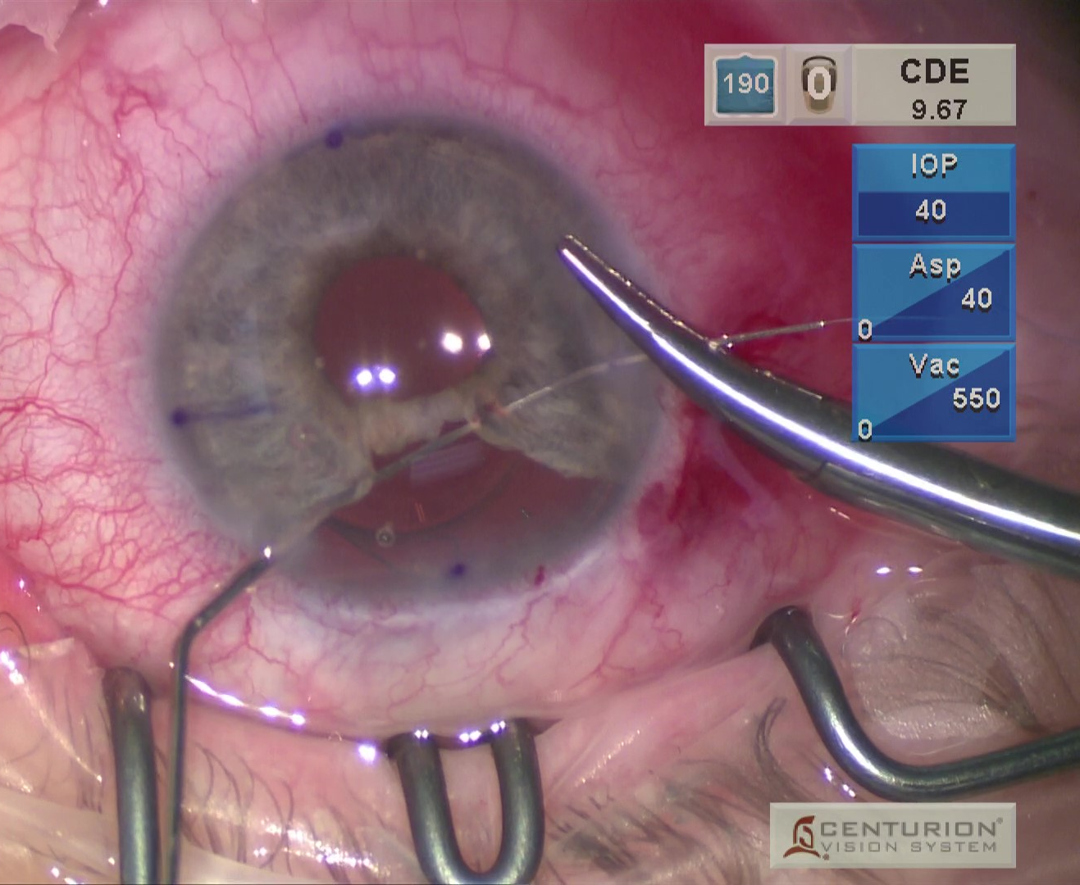
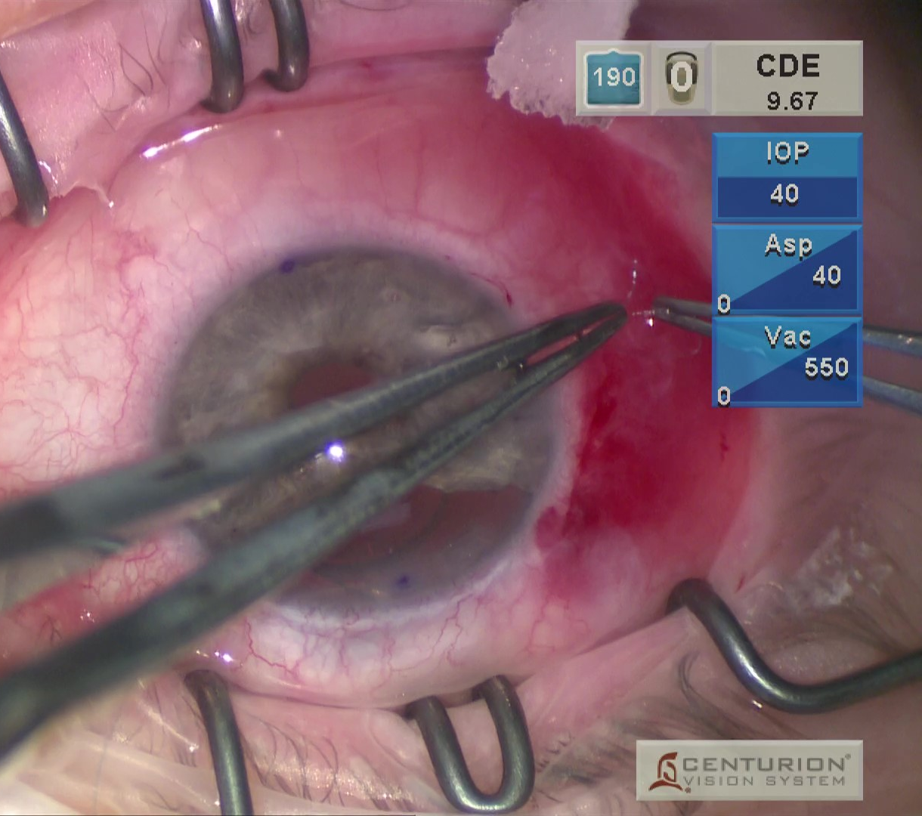
IRIS REPAIR TECHNIQUES
Siepser Sliding Knot
Single-Pass Four-throw Pupilloplasty

Slide 12
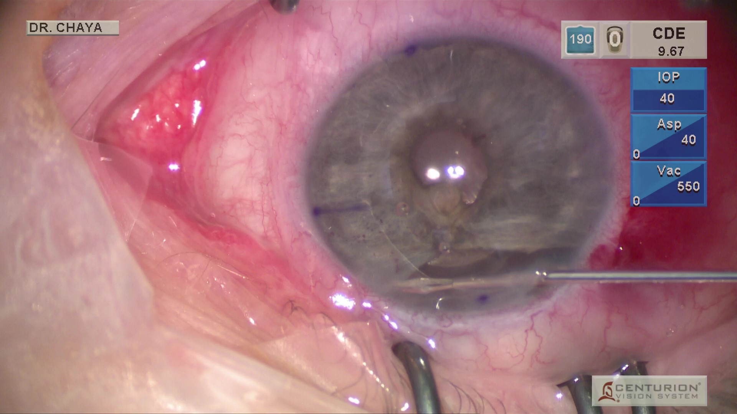
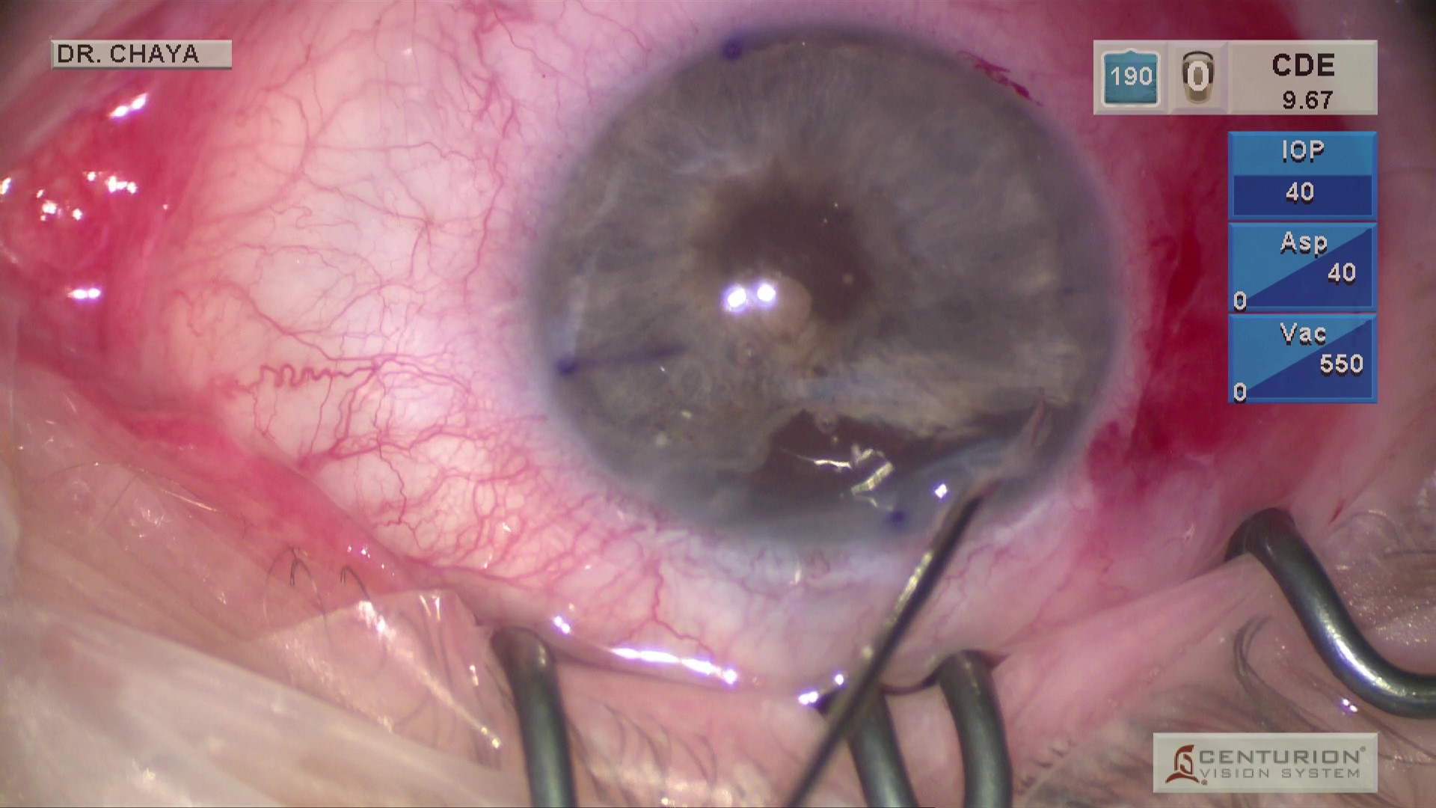
IRIS REPAIR TECHNIQUES
Peripheral Iris Relaxing Incisions

Slide 13
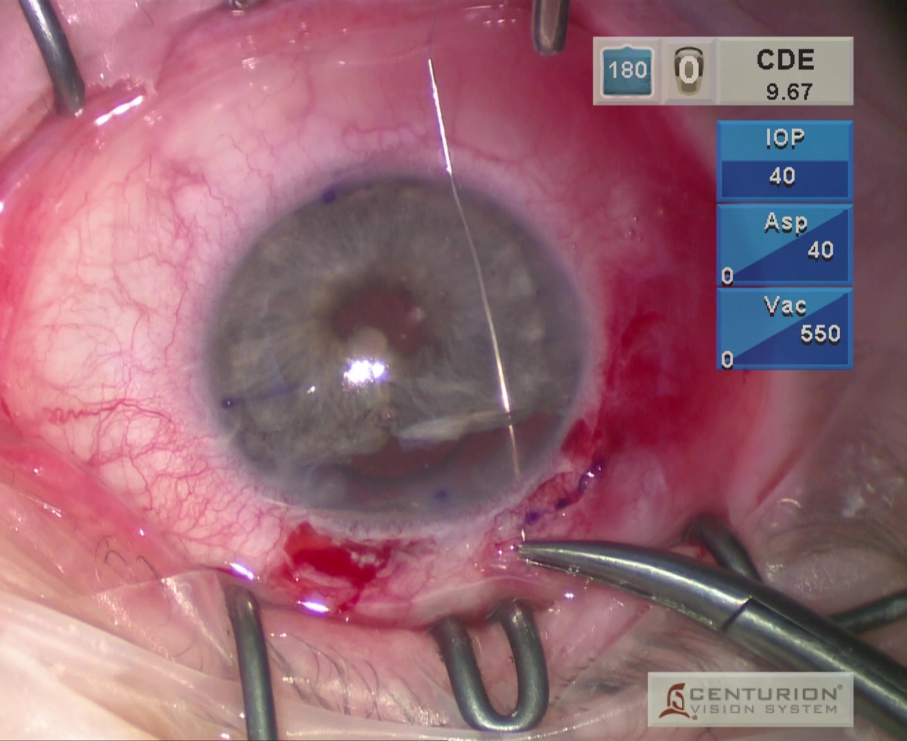
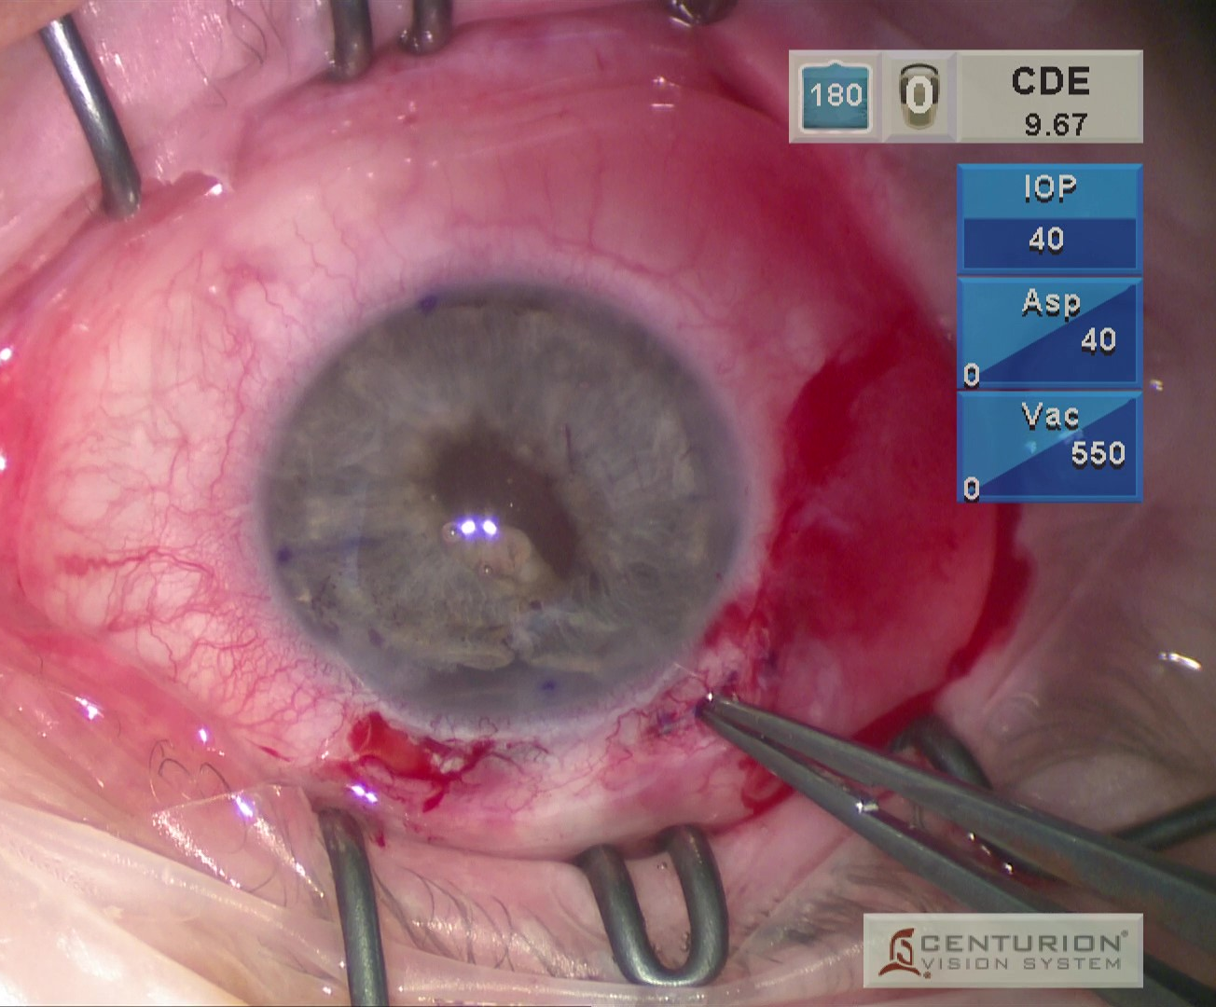
IRIS REPAIR TECHNIQUES
Hang-Back (Non-appositional) Technique

Slide 14
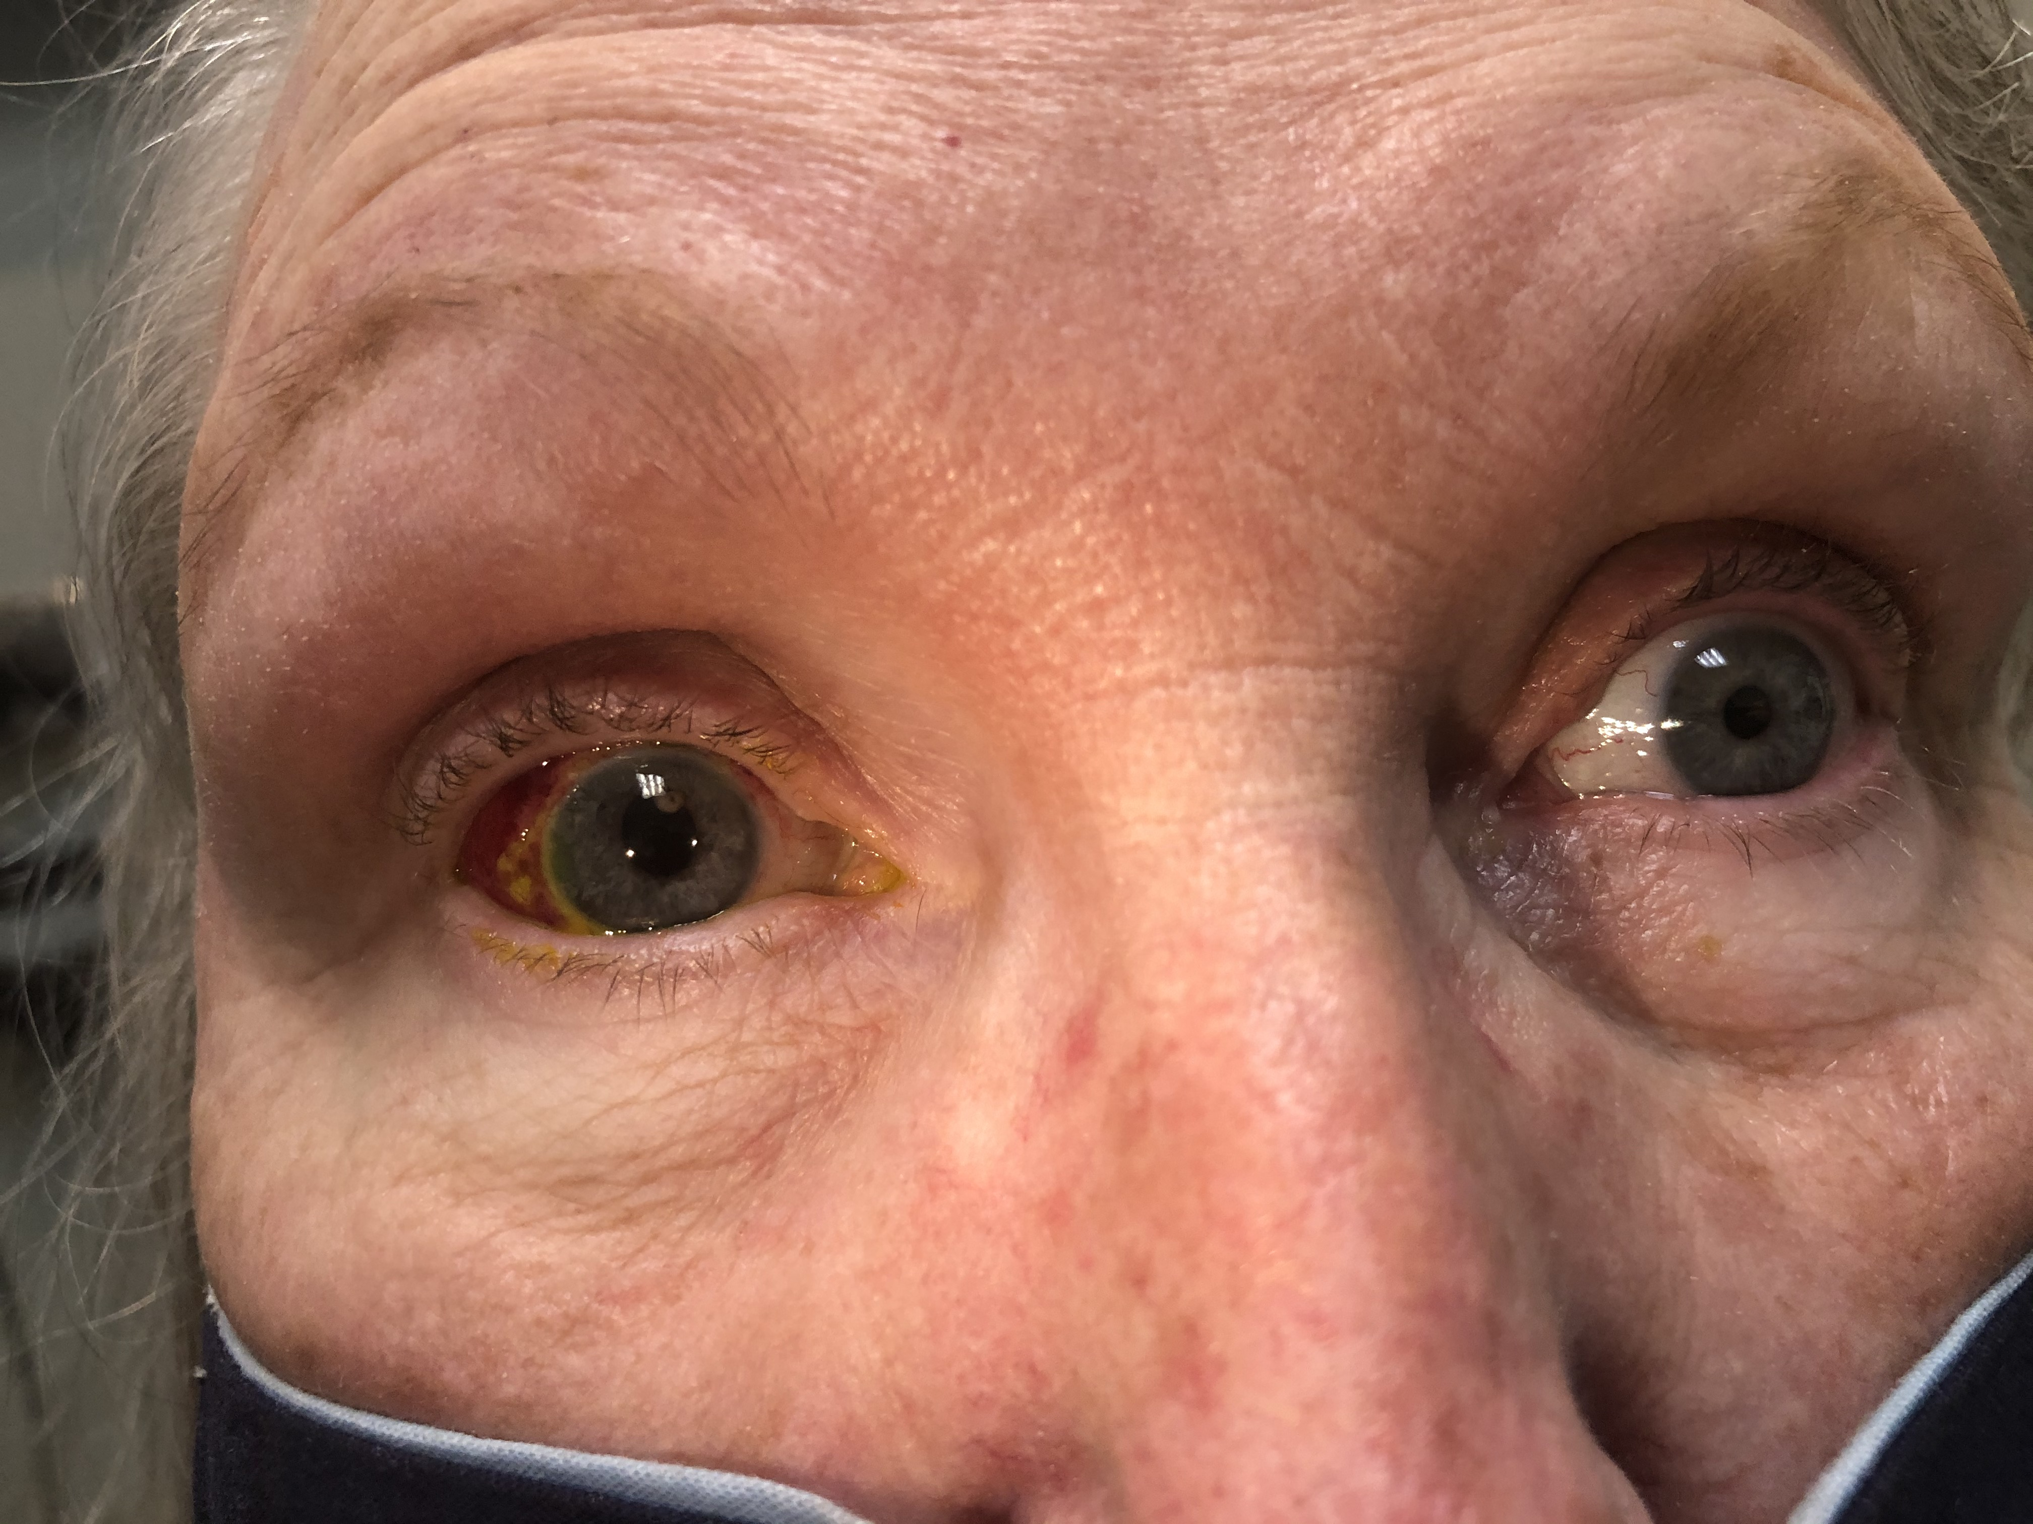
POST OPERATIVE COURSE: POD1

Slide 15
POST OPERATIVE COURSE: POM1
BCVA OD: 20/20 -1
Mild early posterior capsular opacification
Patient very happy with cosmetic result, no dysphotopsias
Notes:
Follow up? Things to look out for?

